Slide 1
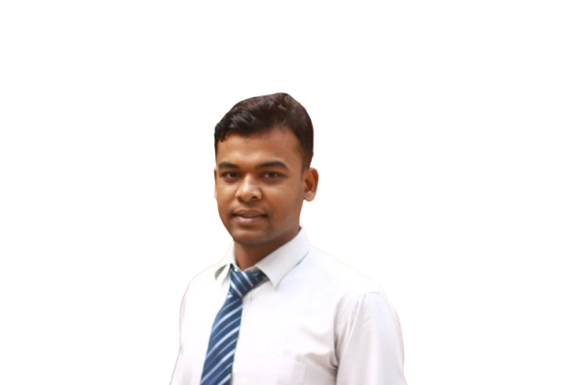
Welcome To My Presentation

Slide 2
Introducing To Myself
Presented by
Abu Hanif

Slide 3
About Myself
Name : Abu Hanif
Father Name: Taslam Uddin
Mother Name:Hafiza Biegum
Address: Parbatipur,dinajpur

Slide 4
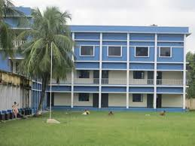
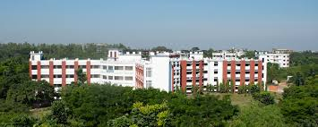
Educational Background
SSC:Cantontent Board High School
HSC:Kholahati Collage
BA(HON’S):Begum Rokeya University, Rangpur
MA: Begum Rokaya University, Rangpur
Cantonment Board High School ,BUSMS
Begum Rokeya University, Rangpur

Slide 5

Computer Skills
Interests and Hobbies
Operating system
Reading And Writing
Internet
Microsoft Office
painting
Sporting
Presentation
Spread Sheet Analysis

Slide 6

Thank You

